Slide 1
Storytelling of movie ratings dataset
Brijesh Kushwaha

Slide 2
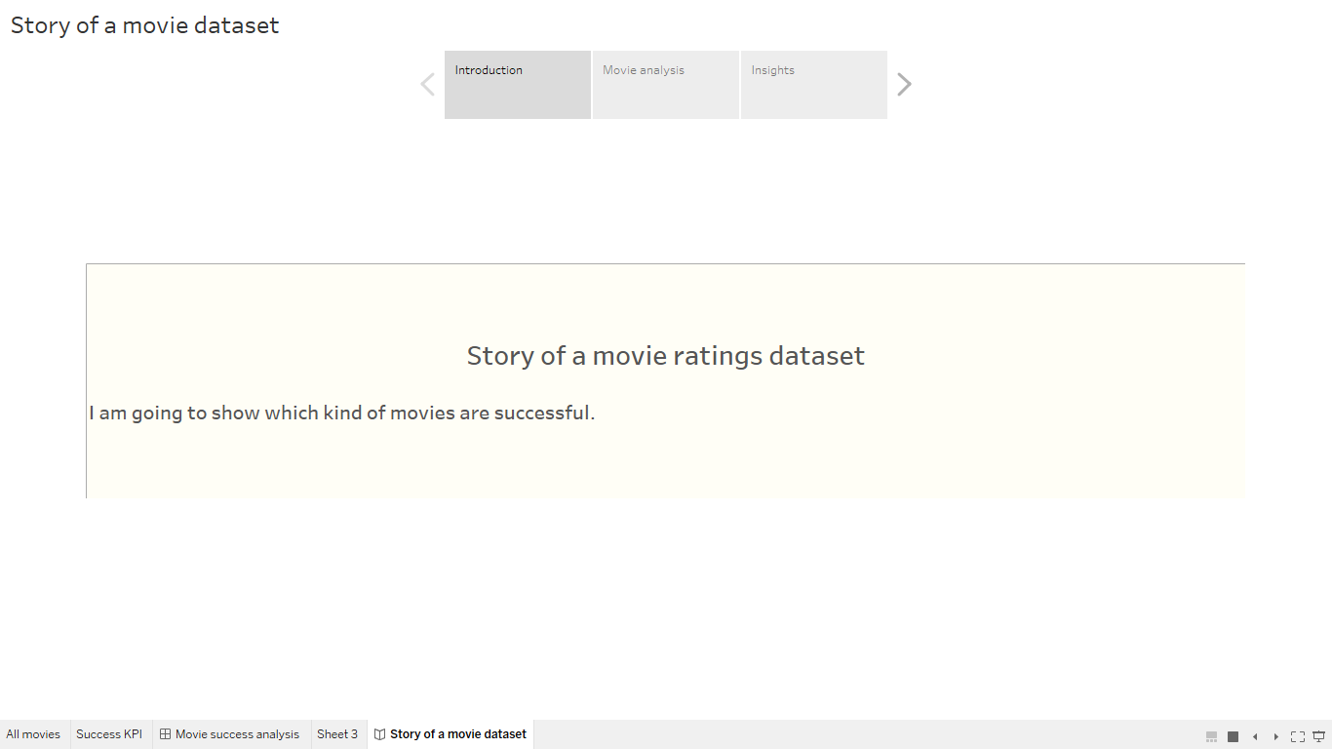

Slide 3
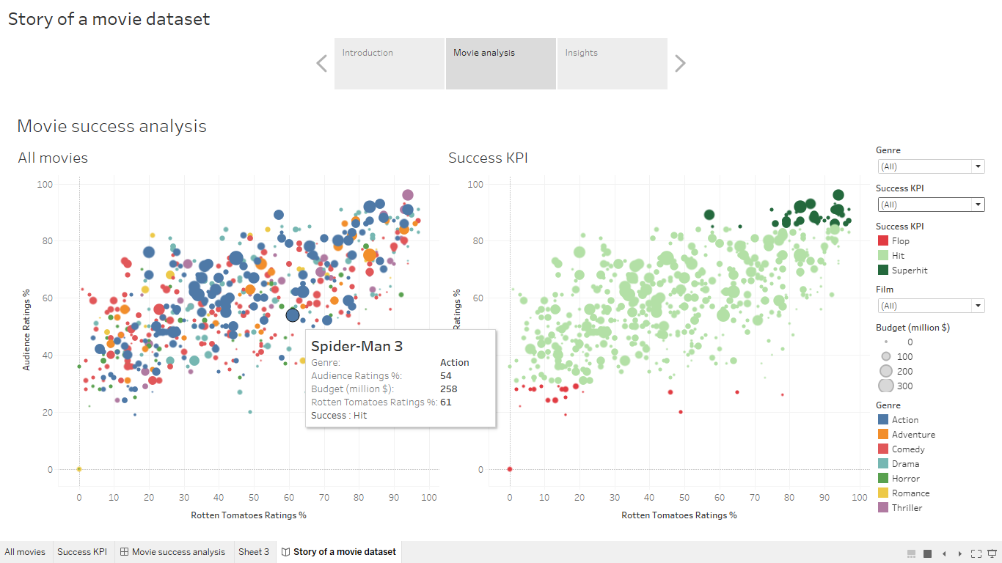

Slide 4
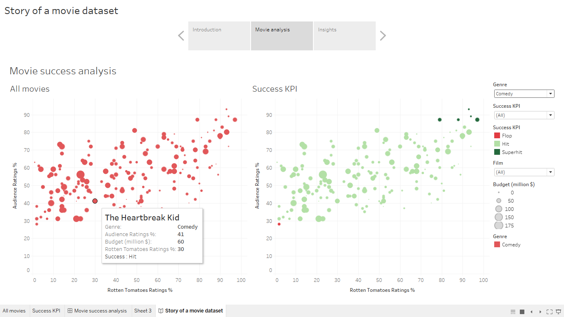

Slide 5
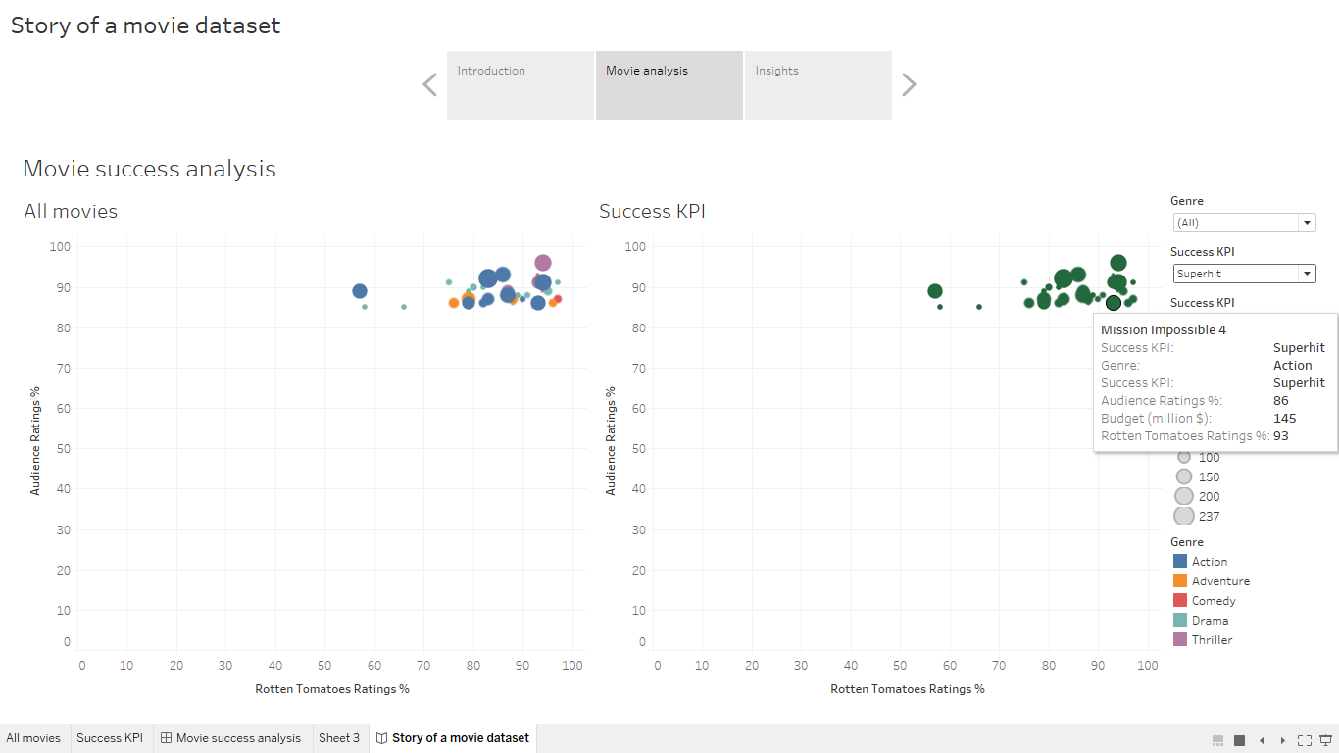

Slide 6
